Slide 1
Comparative Analysis of Interpretable Mushroom Classification using Several Machine Learning Models
Submitted By:
Sadia Afrose 21266004
Md. Sabbir Ahmed 21366035
Ashik Adnan 22166003
Nazifa Khanom 22166009
Submitted To:
Annajiat Alim Rasel
Lecturer, Computer Science and Engineering, BRAC University

Slide 2
Abstract
It’s important to classify edible and poisonous mushrooms.
An interpretable system for the identification of mushrooms is being developed using machine learning methods and Explainable Artificial Intelligence (XAI) models.
Among six ML models, Decision Tree, Random Forest, and KNN performed flawlessly

Slide 3
Introduction
Mushroom has the meaty substance of a fungus which bears lots of spores on its body. It is also known as toadstool and scientifically known as Agaricus bisporus.
Mushroom recently refers to a robotic technique used in the food sector. This method was used to restrict attributes like color.
Many research works have discussed the interpretability of how a model is identifying an instance of mushroom is Edible or Poisonous.
SHAP (SHapley Additive exPlanations) will be used for global explainability and LIME (Local Interpretable Model Agnostic Explanation) for local or individual interpretability.

Slide 4
Related Work
In a paper, it is found that the result of K-NN showed 100% accuracy rate. The reason for having the best result is simply for the dataset which was numeric data with discrete value. This kind of dataset is highly suitable for K-NN algorithm, which is why the accuracy rate is this high.
In another paper, In static dataset, deep CNN or DCNN works better. Based on a CNN model, mushroom is classified to be either edible or not; they had 93% of accuracy.

Slide 5
Related Work
According to the paper, a mushroom is more likely to be inedible if it has an odor. Due to the data set’s cleanliness,the majority of classifiers appear to perform well on it.Nevertheless, the decision tree, ANN, and SVM classifiers perform better than the other classifiers. Moreover, in order to increase accuracy, they proposed a hybrid model that combines the most effective classifiers.
In another paper, certain physical characteristics of mushrooms, such as cup sizes, stem heights, color, and textures can be used for getting better outcome. Their accuracy reached almost 94%.

Slide 6
Dataset
The Audubon Society Field Guide to North American Mushrooms' descriptions of hypothetical samples for 23 species of gilled mushrooms in the Agaricus and Lepiota Family Mushroom are included in this dataset.
The dataset has 8124 rows and 23 columns, and there are 4208 instances of the Edible class and 3916 instances of the Poisonous class. The dataset is therefore balanced.

Slide 7
Model Description
Decision Tree: Decision Tree is a different-supervised regression and classification machine learning approach. Decision trees can be used at classification task, training models to predict the target variable's class or value from prior data (training data). Decision Trees compare root and record attribute values and predict the next node's branch from the tree's root.
Support Vector Machine (SVM): SVM is a supervised technique for classification and regression. SVM classifies future data points by selecting the optimal line or decision boundary, which helps partition n-dimensional space into classes.
Random Forest: The random forest consists of multiple decision trees. It employs bagging and feature randomization to produce an uncorrelated forest of trees whose prediction by committee is more accurate than any individual tree. This approach classifies continuous and categorical variables better than it does regression.

Slide 8
Model Description
Logistic Regression: Logistic regression predicts the likelihood of a target variable using supervised learning classifications. A dichotomous target or dependent variable has only two classifications. Logistic regression is categorical and discrete or categorical results are required here.
K-Nearest Neighbor (KNN): It is a supervised learning classifier which is non-parametric and employs closeness to group data points. It can be used for regression or classification, although it's usually a classification approach that assumes comparable points are close together.
Naive Bayes: It is a Bayes Theorem-based machine learning algorithm used for categorization. A Naive Bayes classifier presupposes that a class's features are unrelated. It's been used for many purposes, but it excels at NLP.

Slide 9
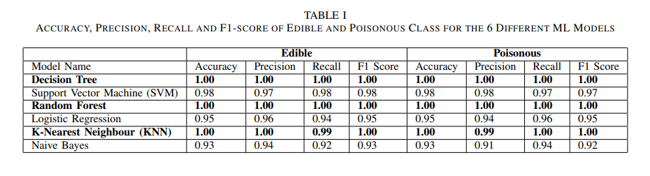
Results and Discussion
Six ML models that we employed for the classification task performed exceptionally well, and among those three, two of them had 100% accuracy rate.
Our best three models are Decision Tree, Random Forest and K-Nearest Neighbour (KNN)

Slide 10
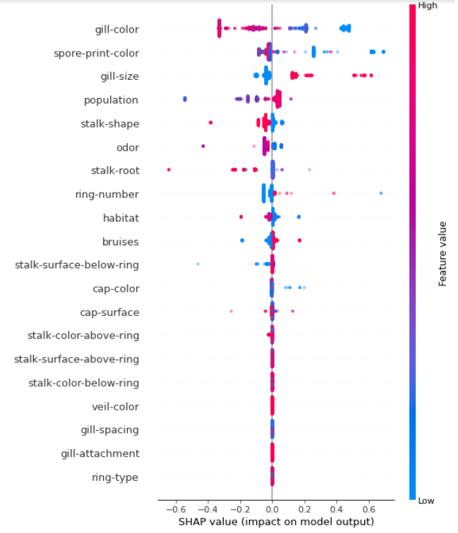
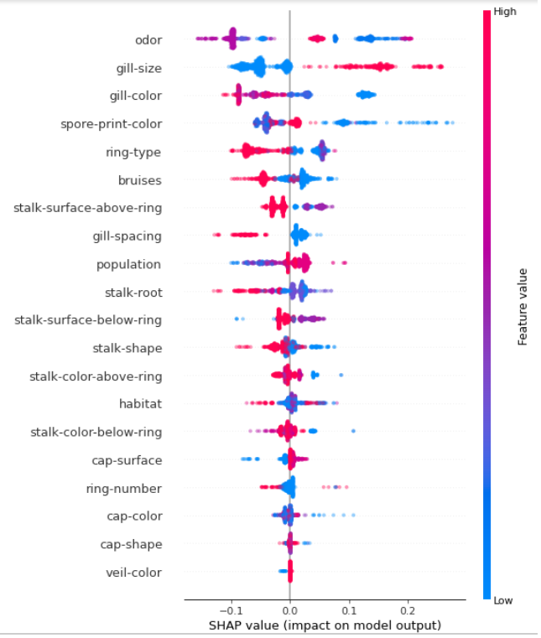
Fig-1: Summary of SHAP values over all features for Decision Tree
Fig-2: Summary of SHAP values over all features for Random Forest

Slide 11
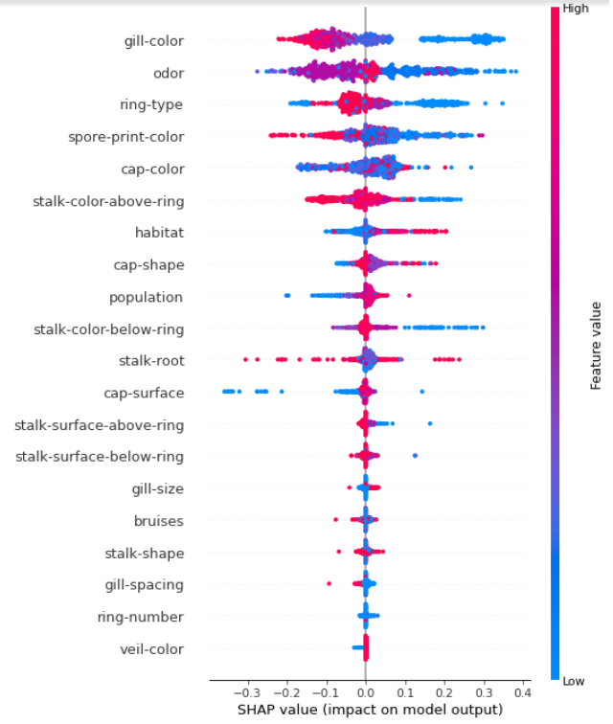
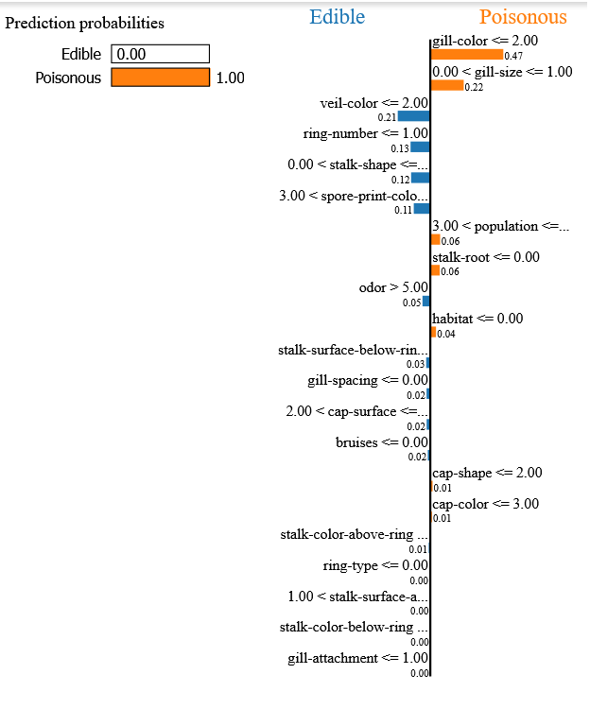
Fig-3: Summary of SHAP values over all features for K-Nearest Neighbour (KNN)
Fig-4: LIME explainability for a single instance of the Decision Tree mode

Slide 12
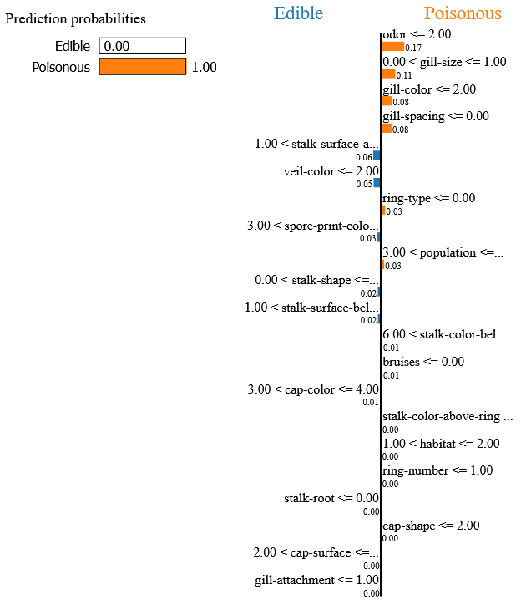
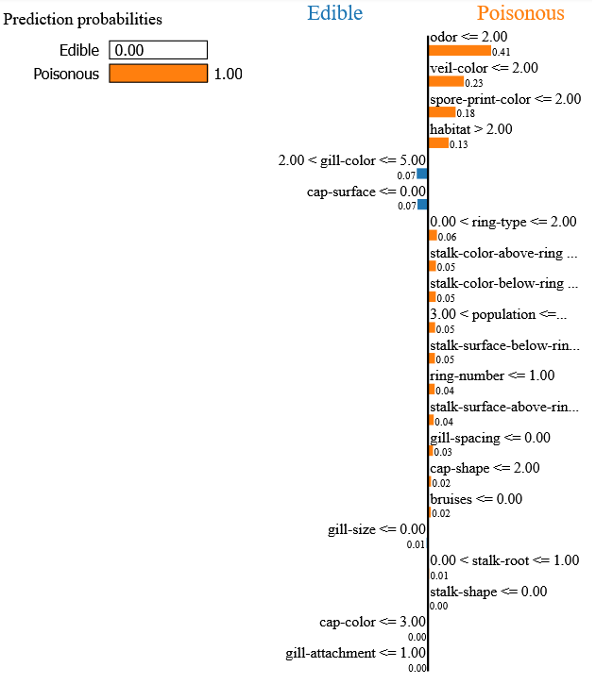
Fig-5: LIME explainability for a single instance of the Random Forest mode
Fig-6: LIME explainability for a single instance of the K-Nearest Neighbour (KNN) mode

Slide 13
Observations from SHAP
Observations from LIME
The three best models for our proposed classification system have been discussed in terms of their SHAP values
It is clear that key features, such as gill color, spore print color, and odor, are shared by all three models as being among their most significant features
Therefore, we may infer that these features are the most crucial characteristics for classifying edible and poisonous mushrooms.
The three best models for our proposed classification system have been discussed in terms of LIME using a single instance
Just like SHAP, LIME also showed that some features plays more important role in case of the classification

Slide 14
Conclusion and Future Work
The objective of our proposed research was to demonstrate the interpretability of machine learning models for classifying edible and poisonous mushrooms.
We demonstrated the global and local interpretability of the top three ML models from our proposed work, and as a result, we obtained some crucial knowledge about the best features for the classification task.
The combination of various XAI models with Deep Learning and Machine Learning models may be a potential future research work.

Slide 15
Thank You

